Slide 1
Diyala University College of Engineering Fourth Year 2012/2013 Computer & Software Engineering Department
Cryptographic Data Integrity Algorithms
Chapter 4/Part3
Digital Signatures
PRESENTED BY
DR. ALI J. ABBOUD

Slide 2
4.3. Objectives
Key points.
Generic Model of Digital Signature Process.
Essential Elements of Digital Signature Process.
Attacks on Digital Signatures.
ELGAMAL DIGITAL SIGNATURE SCHEME.
SCHNORR DIGITAL SIGNATURE SCHEME.
DIGITAL SIGNATURE STANDARD
DIGITAL SIGNATURE Algorithm.
DSS Signing and Verifying.

Slide 3
4.3.1 Key Points
A digital signature is an authentication mechanism that enables the creator of a message to attach a code that acts as a signature. Typically the signature is formed by taking the hash of the message and encrypting the message with the creator’s private key. The signature guarantees the source and integrity of the message.
The digital signature standard (DSS) is an NIST standard that uses the secure hash algorithm (SHA).
The most important development from the work on public-key cryptography is the
digital signature . The digital signature provides a set of security capabilities that
would be difficult to implement in any other way.

Slide 4
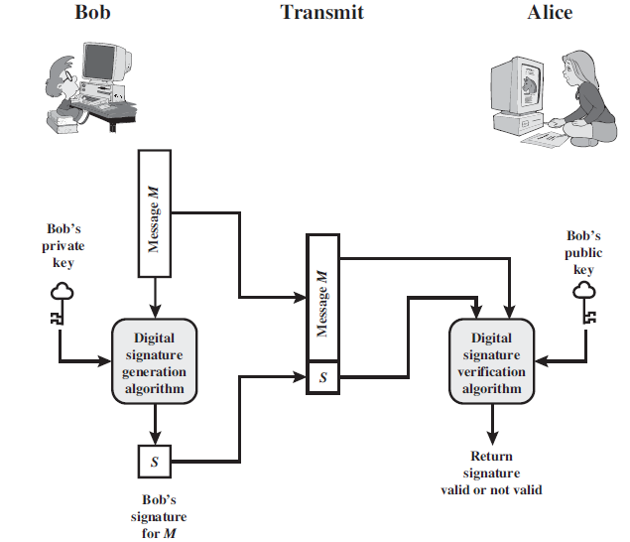
4.3.2 Generic Model of Digital Signature Process

Slide 5
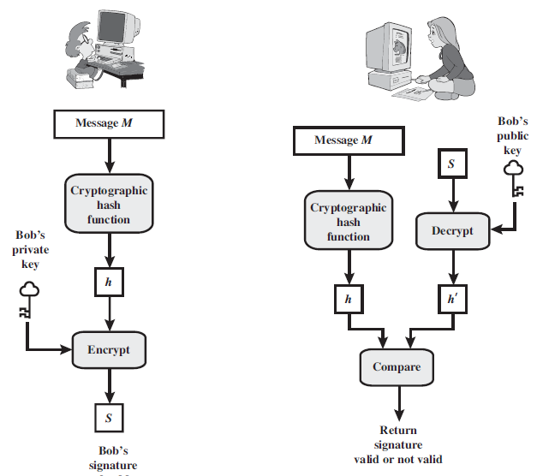
4.3.3 Essential Elements of Digital Signature Process

Slide 6
4.3.4 Essential Elements of Digital Signature Process

Slide 7
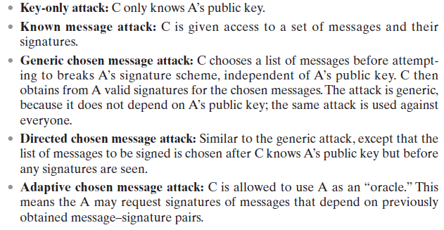
4.3.5 Attacks on Digital Signatures

Slide 8
4.3.5 Attacks on Digital Signatures

Slide 9
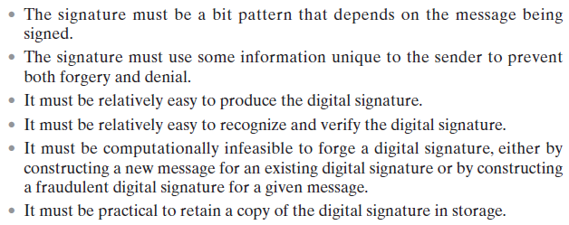
4.3.6 Digital Signature Requirements

Slide 10
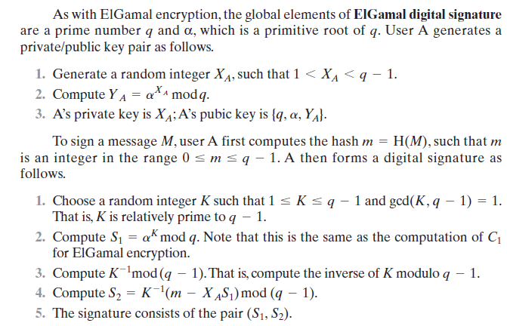
4.3.8 ELGAMAL DIGITAL SIGNATURE SCHEME

Slide 11
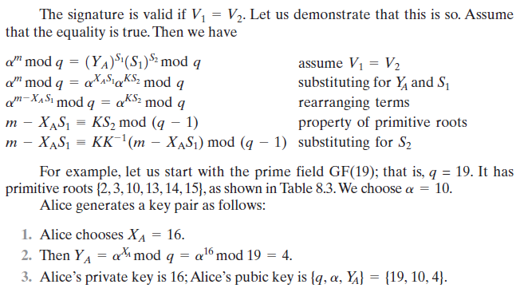
4.3.8 ELGAMAL DIGITAL SIGNATURE SCHEME

Slide 12
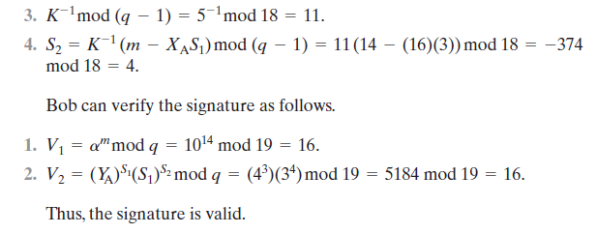
4.3.8 ELGAMAL DIGITAL SIGNATURE SCHEME

Slide 13
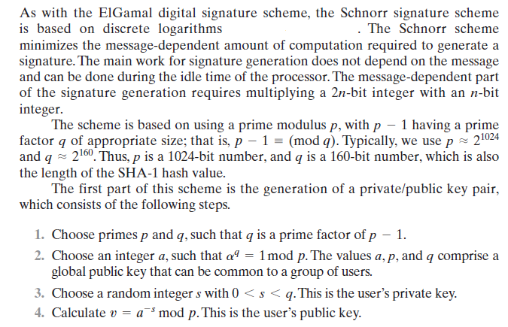
4.3.9 SCHNORR DIGITAL SIGNATURE SCHEME

Slide 14
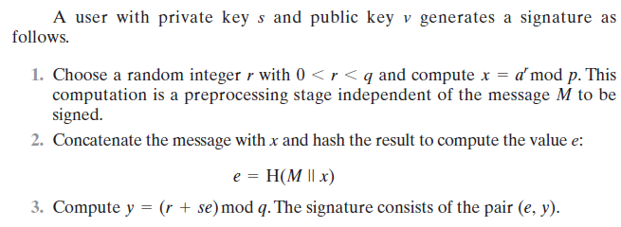
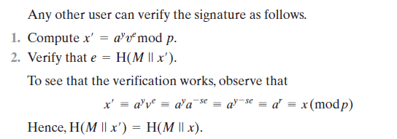
4.3.9 SCHNORR DIGITAL SIGNATURE SCHEME

Slide 15
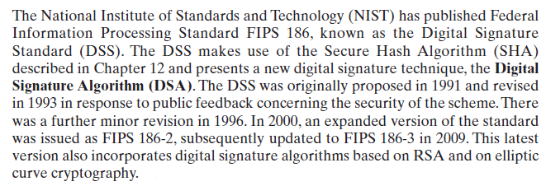
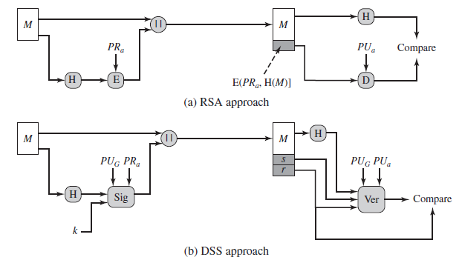
4.3.10 DIGITAL SIGNATURE STANDARD

Slide 16
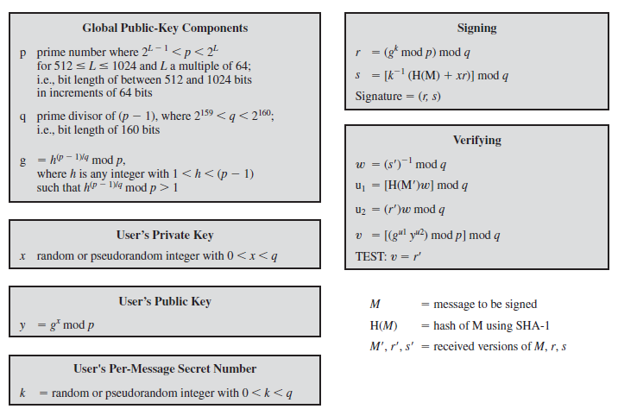
4.3.11 The Digital Signature Algorithm

Slide 17
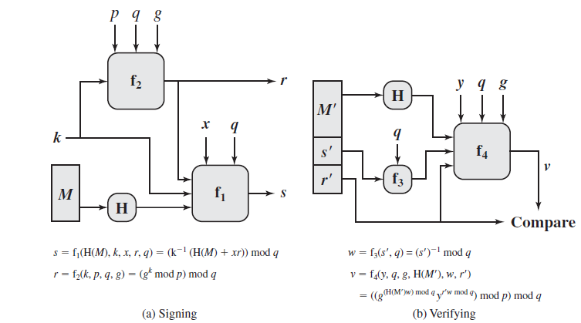
4.3.12 DSS Signing and Verifying

Slide 18
End of Chapter 4/Part3

Slide 19
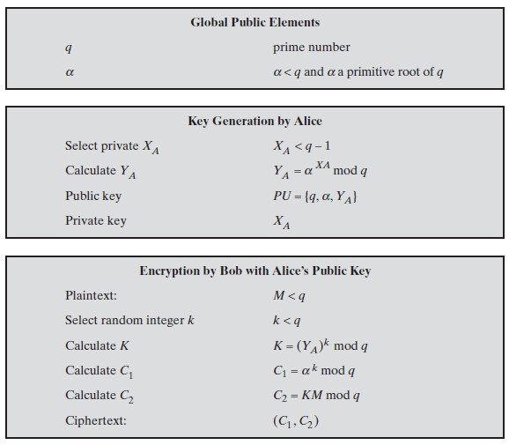
The ElGamal Cryptosystem

